Slide 1

UNIT 1
BY- SIMRAN SHERIFANI

Slide 2
i-o Psychology
According to Wikipedia:
Industrial and Organizational Psychology (I-O Psychology), an applied discipline within psychology, is the science of human behaviour in the workplace.

Slide 3
I-O psychologists
I-O psychologists are trained in the scientist–practitioner model. As an applied field, the discipline involves both research and practice and I-O psychologists apply psychological theories and principles to organizations and the individuals within them. They contribute to an organization's success by improving the job performance, wellbeing, motivation, job satisfaction and the health and safety of employees.

Slide 4
MAJOR SIDES OF PSYCHOLOGY
INDUSTRIAL
I-O PSYCHOLOGY
ORGANIZATIONAL
Involves looking at how to best match individuals to specific job roles.
Focused on understanding how organizations affect individual behaviour.

Slide 5
Six Key Subject Areas
EMPLOYEE SELECTION
ERGONOMICS
ORGANIZATIONAL DEVELOPMENT
PERFORMANCE MANAGEMENT
TRAINING AND DEVELOPMENT
WORK LIFE

Slide 6
topics addressed by industrial-organizational psychology experts
EMPLOYEE TESTING
EMPLOYEE MOTIVATION
LEADERSHIP
WORKPLACE PERFORMANCE
PRODUCT DESIGN
WORKPLACE DIVERSITY

Slide 7
What is research?
Research is "creative and systematic work undertaken to increase the stock of knowledge" It involves the collection, organization and analysis of evidence to increase understanding of a topic.

Slide 8
RESEARCH METHODS
INTERVIEWS
SURVEYS & QUESTIONNAIRE
FOCUS GROUPS
OBSERAVTIONS
QUALITATIVE
QUANTITATIVE
OBSERAVTIONS
TYPES
DOCUMENT SCREENING
DOCUMENT ANALYSIS
LIFE STORIES
EXPERIMENTS

Slide 9
Statistics
Statistics is the science concerned with developing and studying methods for collecting, analysing, interpreting and presenting empirical data.

Slide 10
methods of Statistics
DESCRIPTIVE
INFERENTIAL
Summarizes data using mean & median
To draw conclusions

Slide 11
Evidence-based Practice
1. Ask a question
5. Evaluate Outcome
STEPS
2. Find the best Evidence
4. Apply information in combination with clinical experience and patient values
3. Evaluate Evidence

Slide 12
Context of industrial psychology
GOVERNMENT
ACADEMIA
CONTEXT of I/O PSYCHOLOGY
BUSINESS
CONSULTING FIRM

Slide 13
Job analysis
DETERMINATION
REQUIRED KNOWLEDGE, SKILLS & ABILITIES
IMPORTANCE

Slide 14
competency model
A competency model is a collection of competencies that together define successful performance in a particular work setting. Competency models are the foundation for important human resource functions such as recruitment and hiring, training and development, and performance management.

Slide 15
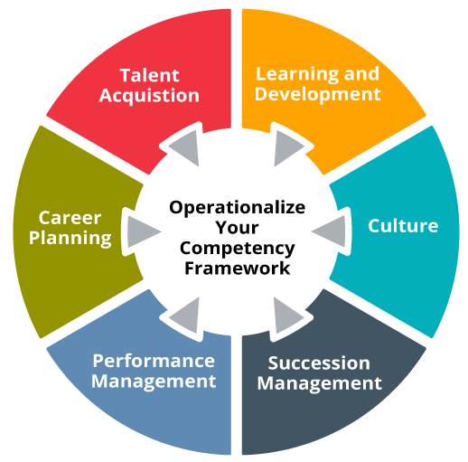

Slide 16
job evaluation
A job evaluation is a systematic way of determining the value/worth of a job in relation to other jobs in an organization. It tries to make a systematic comparison between jobs to assess their relative worth for the purpose of establishing a rational pay structure.

Slide 17
JOB ANALYSIS
Quantitative /Analytical
Point-Rating Method
Factor Comparison Method
Qualitative/
Non-Analytical
Ranking Method
Job Classification or Job Grading Method

Slide 18
Job Design
Job design refers to what, how much, how many, and the order of the tasks for a job. It organizes the job’s tasks and functionalities for maintaining better relationships among the levels of the organizational chain.

Slide 19
Culture
Employee availability & abilities
Environmental Factors
Behavioural Factors
Organizational Factors
Work Nature
Work Flow
Socio-economic and cultural prospects.
Ergonomics
Factors Affecting
Job Design
Feedback
Autonomy
Use of Skills and abilities
Diversity

Slide 20
Employee Well-Being
Employee wellbeing is defined as the overall mental, physical, emotional, and economic health of your employees. It’s influenced by various factors such as their relationships with co-workers, the decisions they make, and the tools and resources they have access to. Hours, pay, and workplace safety also have a significant impact on employee wellbeing.

Slide 21
5 Ways improve Employee well being
Identify possible drivers of stress.
Implement employee mental health programs.
Encourage Mindfulness in the workplace.
Offer fun activities to recharge employees.
Recognize employees for their hard work.

Slide 22
Recruitment
Recruitment refers to the process of identifying, attracting, interviewing, selecting, hiring and on-boarding employees. In other words, it involves everything from the identification of a staffing need to filling it. Depending on the size of an organization, recruitment is the responsibility of a range of workers.

Slide 23
Criteria for evaluation employee
Objective performance criteria involve the measurement of some easily quantifiable aspects of job performance, such as the number of units produced, the dollar amount of sales, or the time needed to process some information.
Subjective performance criteria consist of judgments or ratings made by some knowledgeable individual, such as a worker’s supervisor or co-worker. These criteria are often used when objective criteria are unavailable, difficult to assess, or inappropriate.

Slide 24
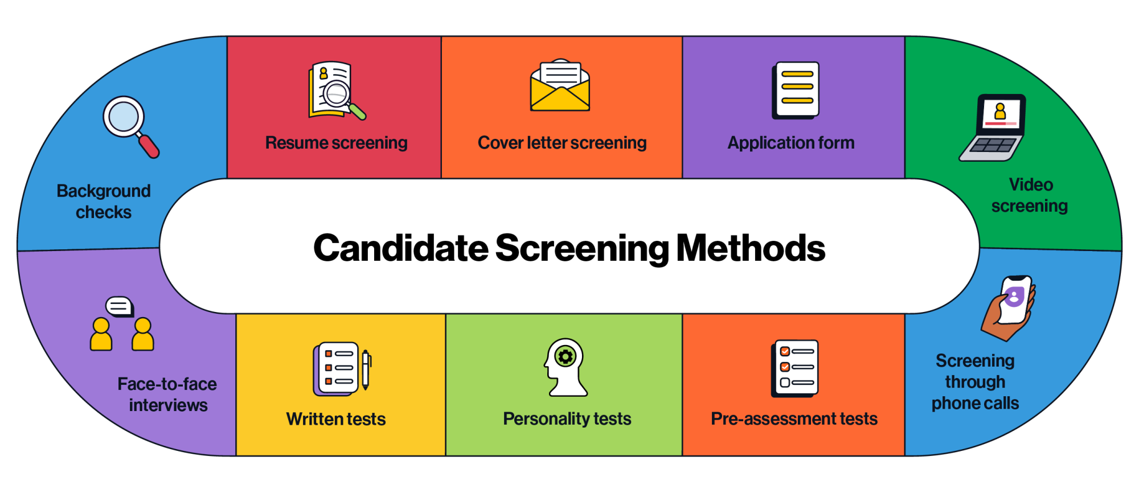
Screening Methods

Slide 25
Thank You!!

